Slide 1
Software Testing
Specification-Based, Unit, Boundary Value Testing
Presented By
Ning Chen, Ph.D.
Professor
Department of Computer
Science
California State University,
Fullerton
© Ning Chen, 2017
*

Slide 2
Module Objectives
This module focuses on the Specification-Based, Unit Testing (Boundary Value Testing)

Slide 3
How to come up with “enough” test cases?
Do we have a way to come up with “enough” test cases for the triangular test example discussed before?
  If we do, can we claim that it is systematic, generalized, or holistic? Or, better, can it offer us some sense of confidence? Research done in the past claims that yes, we do have some ways. One of them is called Boundary Value Testing.

Slide 4
Boundary Value Testing
The full name should be called:
  specification-based, unit, boundary value testing
  Strictly speaking, the full name of this testing method that applies to our triangle problem should be called specification-based, unit, and boundary value testing. Although no one wants to use this long name, it is essential to realize that in terms of use of source code, it is specification-based (instead of code-based) or, if you are a practitioner, black-box. In terms of levels, it is a unit testing for the given problem.

Slide 5
Forms of Boundary Value Testing
Normal boundary value testing
Robust normal boundary value testing
Worst-case value testing
Robust worst-case value testing

Slide 6
Two Logical Questions you may have
What is boundary value testing?
Why do we have four different kinds of boundary value testing?

Slide 7
What?
Boundary testing or boundary value analysis, is where test cases are generated using the extremes of the input domain, e.g. maximum, minimum, just inside/outside boundaries, typical values, and error values.

Slide 8
Case Study
Suppose you have two variables as the input domain of a function F, say, F(x1, x2). We are also given that a <= x1 <= b and c <= x2 <=d.

Slide 9
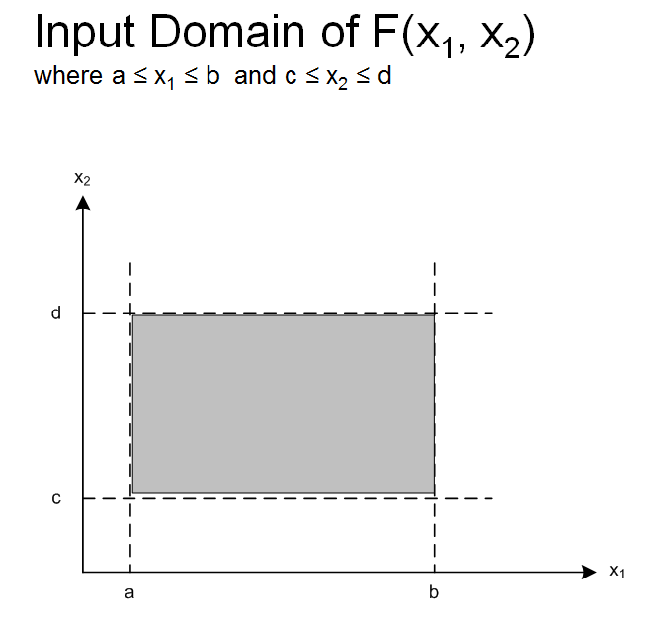
Graphical Representation of the Input Domain

Slide 10
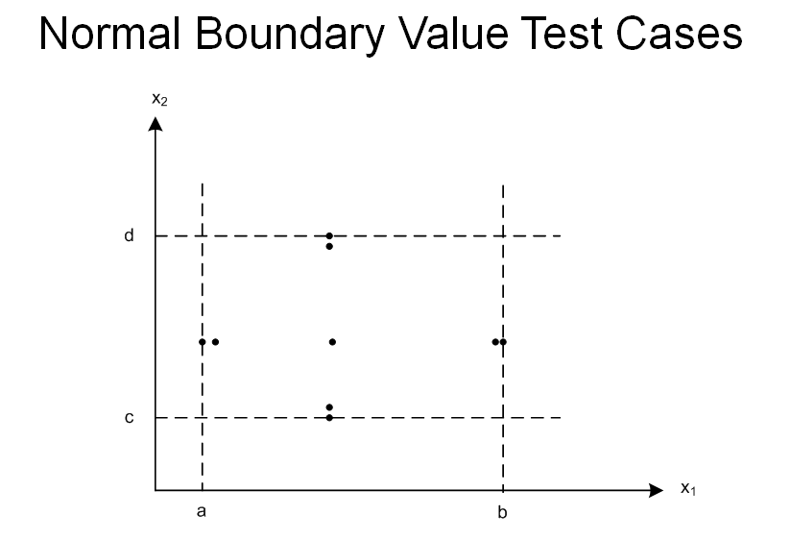
Normal Boundary Value Test Cases

Slide 11
Selection Mechanism
If you notice, here, we do not include the outside boundaries. This is the reason that the selected dots on the above graph are falling inside the boundary.
Selection of a typical value (or, you can call it a normal value) is easy. You select a value of x1 which is between a and b. Select a value of x2 which is between c and d.
The selection of other dots on the above graph requires a bit careful observation. If you hold x1 at its “normal/typical/average/middle” value and vary x2 to its at-the-boundary and just-inside-the-boundary, you end up with four more dots. If you repeat this step by holding x2 at its “normal” value and vary x1, you gain four more dots. Do we have a name that is used to label this type of selecting boundary values for testing? Yes. People call it Normal Boundary Value Testing.

Slide 12
Why?
Any justification why you want to hold one variable at its normal value and vary others
the reliability theory claims that failures are rarely the result of the simultaneous occurrence of two or more faults – Single Fault Reliability Theory.

Slide 13
Robust Normal Boundary Value Testing
How about the outside boundaries?

Slide 14
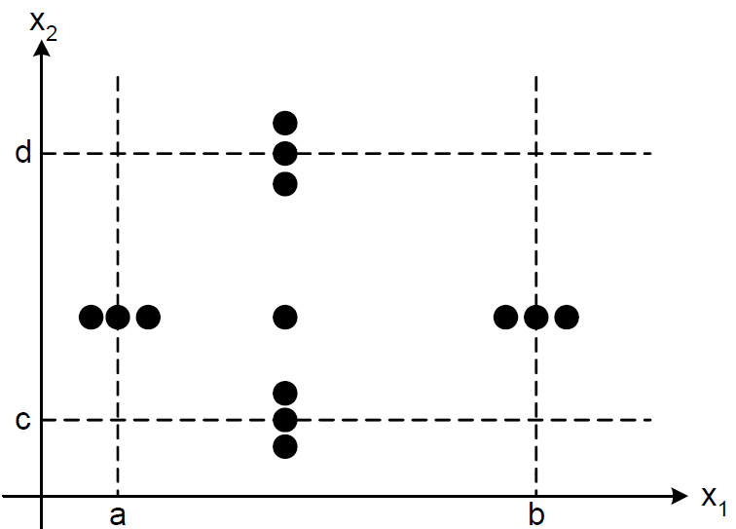
Robust Normal Boundary Value Testing

Slide 15
Robust Normal Boundary Value Testing
Including outside boundaries adds four more dots on the graph and deserves a new name and we call it Robust Normal Boundary Value Testing.
  Some literature calls it Robust Boundary Value Testing (omitting the term Normal). We don’t like it. Shortening a name in some case is not that worthy. Without the term Normal in the name, you may think this is a brand new approach. No. It is just an extension of the Normal Boundary Value Testing.

Slide 16
Wait a Minute!
I am not a believer of the single fault reliability theory!
I worry that a fault may be triggered by some specific values of x1 and x2 combination.
How should I do?

Slide 17
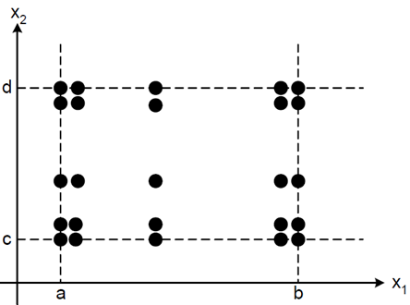
Worst-Cast Boundary Value Testing

Slide 18
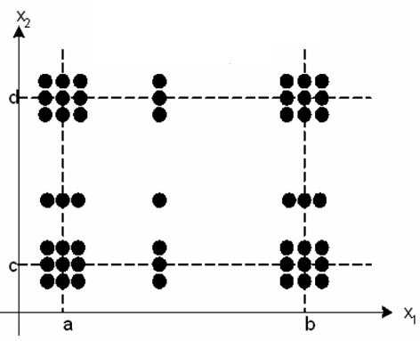
Robust Worst-Case Boundary Value Testing.

